Slide 1
JAVASCRIPT TYPEDARRAY

Slide 2
JavaScript TypedArray
The JavaScript TypedArray object illustrates an array like view of an underlying binary data buffer
There are many number of different global properties, whose values are TypedArray constructors for specific element types, listed below

Slide 3
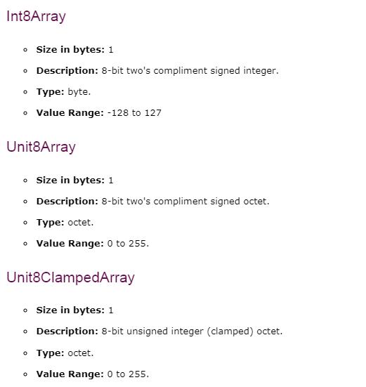
Types of TypedArray

Slide 4
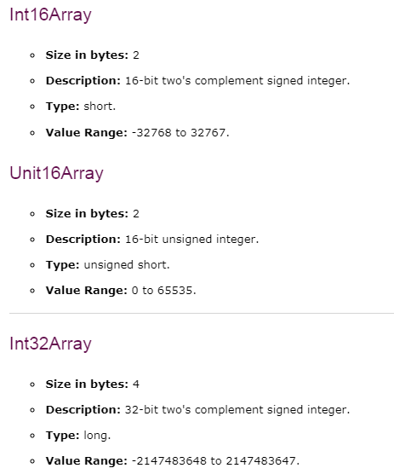
Types of TypedArray

Slide 5
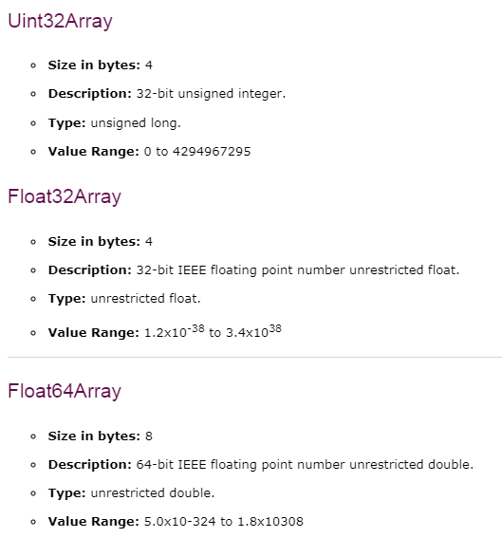
Types of TypedArray

Slide 6
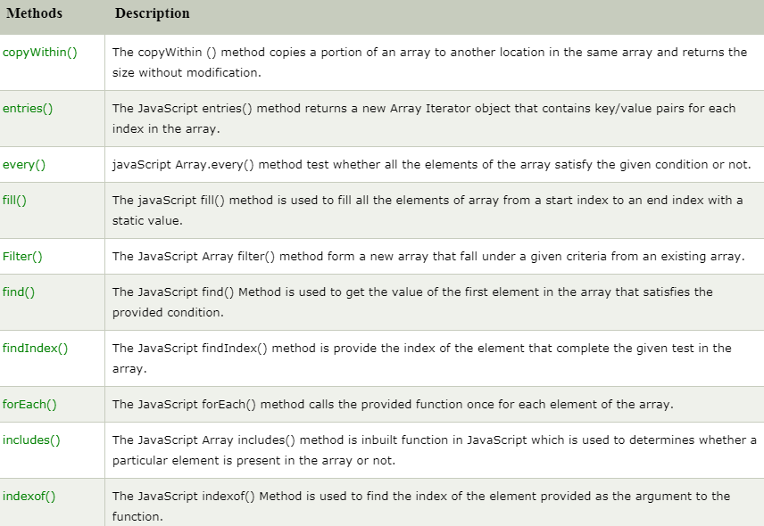
JavaScript TypedArray Methods

Slide 7
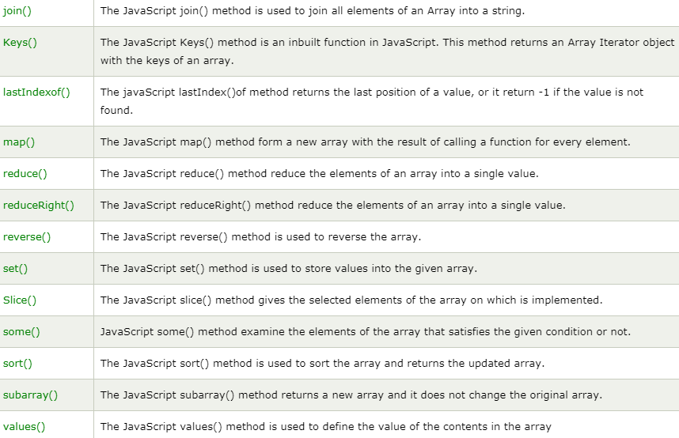

Slide 8


